Slide 1
Abstraction in Java

Slide 2
Abstraction in JAVA
Abstraction in Java is the process in which we only show essential details/functionality to the user. The non-essential implementation details are not displayed to the user.
Simple Example to understand Abstraction:
Television remote control is an excellent example of abstraction. It simplifies the interaction with a TV by hiding the complexity behind simple buttons and symbols, making it easy without needing to understand the technical details of how the TV functions.

Slide 3
What is Abstraction in Java?
In Java, abstraction is achieved by interfaces and abstract classes. We can achieve 100% abstraction using interfaces.
Abstraction is a process of hiding the implementation details and showing only functionality to the user.
Abstraction lets you focus on what the object does instead of how it does it.

Slide 4
Data Abstraction
Data Abstraction may also be defined as the process of identifying only the required characteristics of an object ignoring the irrelevant details. The properties and behaviours of an object differentiate it from other objects of similar type and also help in classifying/grouping the objects.
Consider a real-life example of a man driving a car. The man only knows that pressing the accelerators will increase the speed of a car or applying brakes will stop the car, but he does not know how on pressing the accelerator the speed is actually increasing, he does not know about the inner mechanism of the car or the implementation of the accelerator, brakes, etc in the car. This is what abstraction is.

Slide 5
JAVA Abstract Classes
A class which is declared as abstract is known as an abstract class. It can have abstract and non-abstract methods. It needs to be extended and its method implemented. It cannot be instantiated.
It can have final methods which will force the subclass not to change the body of the method.
Any class that contains one or more abstract methods must also be declared with an abstract keyword.
There can be no object of an abstract class. That is, an abstract class can not be directly instantiated with the new operator

Slide 6
Points to be Noted
An abstract class is a class that is declared with an abstract keyword.
An abstract method is a method that is declared without implementation.
An abstract class may or may not have all abstract methods. Some of them can be concrete methods
A method-defined abstract must always be redefined in the subclass, thus making overriding compulsory or making the subclass itself abstract.
An abstract class can have parameterized constructors and the default constructor is always present in an abstract class.
It can contain static,non static, final and non-final fields and methods.

Slide 7
Example
class Honda4 extends Bike {
void run() {
System.out.println("running safely"); } }
public static void main(String args[])
{
Bike obj = new Honda4();
obj.run();
}
abstract class Bike
{
abstract void run();
}

Slide 8
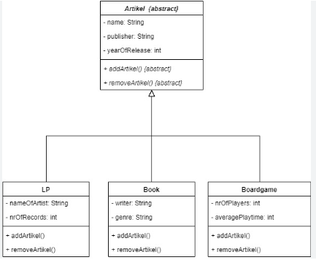
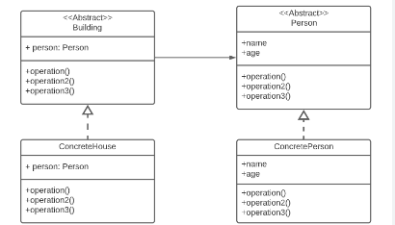
Abstraction In Class Diagram

Slide 9
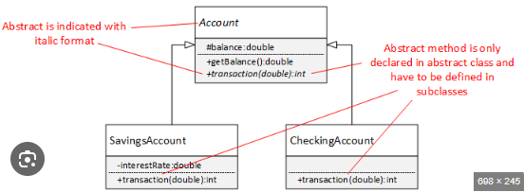
Abstraction In Class Diagram

Slide 10
